Slide 1
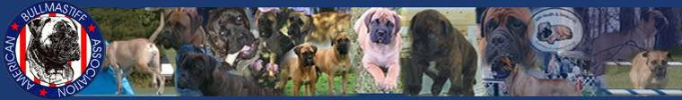
The American Bullmastiff Association Judges Education Program

Slide 2

Judges Education Committee
Mary Barbara Walsh, Chairman Julie Ahrens
Sherry Boldt Denise Borton Helene Nietsch

Slide 3
Introduction
Welcome to the wonderful world of the Bullmastiff.
We as judges, breeders and owners of this wonderful breed appreciate the fact that you have chosen to become educated in the specifics of the breed to better judge and breed them.
Please note that some of the content of this presentation and this material may seem to present information with which you are already familiar in terms of general anatomy and gait. The latter is because we chose to increase the education in our chosen breed and some may not have the background and expertise specifically required.
Mission Statement: The mission of the Judge's Education Committee is to extend knowledge to active and aspiring judges, mentors, breeders, conformation and performance exhibitors, handlers, and the general fancy. Dedicated and knowledgeable ABA members will create an educational environment providing accurate and responsive materials at shows, seminars, and on the internet.
Thank you for your interest.

Slide 4
Bullmastiff Breed Standard
General Appearance - That of a symmetrical animal, showing great strength; powerfully built, but active. The foundation breeding was 60% Mastiff and 40% Bulldog.
The breed was developed in England by gamekeepers for protection against poachers.
Size, Proportion, Substance - Size: Dogs, 25 to 27 inches at the withers, and 110 to 130 pounds weight. Bitches, 24 to 26 inches at the withers, and 100 to 120 pounds weight. All things being equal, the more substantial dog within these limits is favored. Proportion: The length from tip of breastbone to rear of thigh exceeds the height from withers to ground only slightly, resulting in a nearly square appearance.
Head - Expression: Keen, alert and intelligent. Eyes: dark and medium size. Ears: V-shaped and carried close to the cheeks, set on wide and high, level with the occiput and cheeks, giving a square appearance to the skull; darker in color than the body and medium in size. Skull: Large, with a fair amount of wrinkle when alert; broad, with cheeks well developed. Forehead flat. Stop: moderate. Muzzle: broad and deep; its length in comparison with that of the entire head, approximately as 1 is to 3. Lack of foreface with nostrils set on top of muzzle is a reversion to the Bulldog and is very undesirable. A dark muzzle is preferable. Nose: black with nostrils large and broad. Flews: not too pendulous. Bite: preferably level or slightly undershot. Canine teeth large and set wide apart.
Neck, Topline, Body - Neck: slightly arched, of moderate length, very muscular, and almost equal in circumference to the skull. Topline: Straight and level between withers and loin. Body: Compact. Chest wide and deep, with ribs well sprung and well set down between the forelegs. Back: short, giving the impression of a well- balanced dog. Loin: wide, muscular and slightly arched, with fair depth of flank. Tail: set on high, strong at the root and tapering to the hocks. It may be straight or curved, but never carried hound fashion. Forequarters: shoulders muscular but not loaded, and slightly sloping. Forelegs straight, well boned and set well apart; elbows turned neither in nor out. Pasterns straight, feet of medium size, with round toes well arched. Pads thick and tough, nails black. Hindquarters: broad and muscular and well-developed second thigh denoting power, but not cumbersome. Moderate angulation at hocks. Cowhocks and splay feet are serious faults.
Coat - Short and dense, giving good weather protection. Color: red, fawn or brindle. Except for a very small white spot on the chest, white marking is considered a fault.
Gait - Free, smooth, and powerful. When viewed from the side, reach and drive indicate maximum use of the dog’s moderate angulation. Back remains level and firm. Coming and going, the dog moves in a straight line. Feet tend to converge under the body, without crossing over, as speed increases. There is no twisting in or out at the joints.
Temperament - Fearless and confident yet docile. The dog combines the reliability, intelligence, and willingness to please required in a dependable family companion and protector.
Approved March 1992

Slide 5
Table of Contents
Introduction
Bullmastiff Standard
  Bullmastiff History
    Early Bullmastiffs
      Order of Priority
General Appearance
Size, Proportion, Substance
  Bullmastiff Ideal Male
Bullmastiff Typical Female
  Head
Neck, Topline, Body
  Coat
Color
  Gait
Temperament
Serious Faults
  Summary
Maturity in a Bullmastiff – Body
Maturity in a Bullmastiff – Head
Bullmastiff / Mastiff Comparison
  Recommended Reading
    Photos

Slide 6
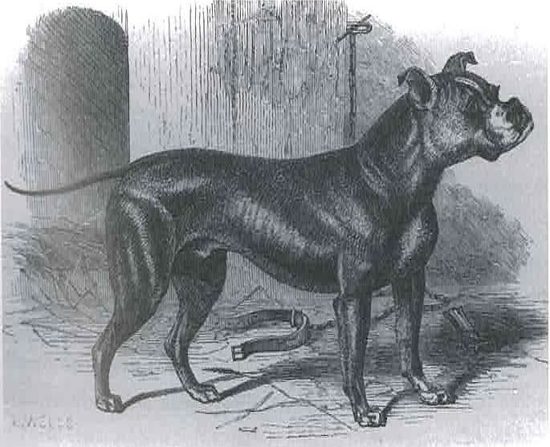
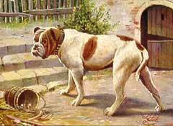
Bullmastiff History
In the early 19th century, English gamekeepers created this noble breed by crossing the courageous Mastiff with the tenacious Bulldog to create fleet- footed, powerful dogs for protection against poachers. Originally called the "Gamekeepers Night Dog,” these dogs combined tremendous strength and guarding instinct within affectionate disposition and devotion to their master. Originally 60% Mastiff and 40% Bulldog, the Bullmastiff was recognized in England in 1924, and by the American Kennel Club in 1933.
The Bullmastiff is an intelligent dog and has a definite mind of his own. His independence of spirit makes a relationship with him more of a working partnership than the conventional dog/master association which some people might expect.
A Bullmastiff will give a family boundless love and devotion, but will retain a part of himself as a free spirit, capable of making his own decisions and acting on them. Children will be his charges to protect and to love, but they must respect him and not be allowed to tease him.
He asks only to be as much of the family as possible. He will reward such treatment with devotion and friendship which is not exceeded in any breed.

Slide 7
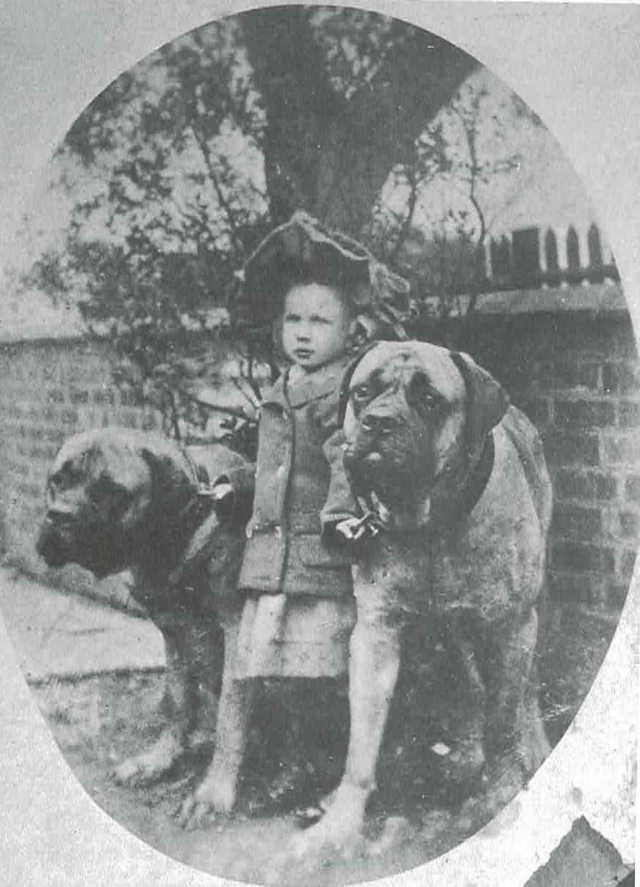
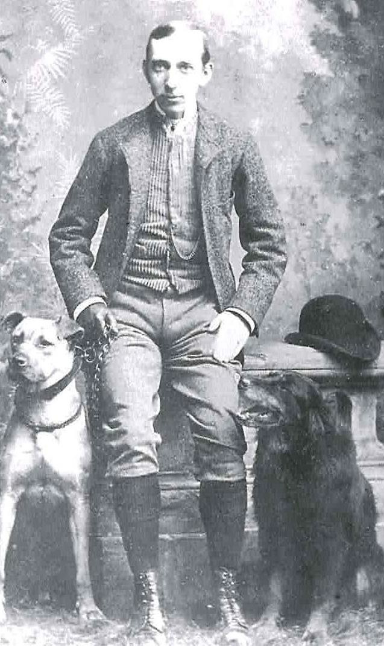
Bullmastiff History
This child was a gamekeeper’s daughter and the two dogs probably Bullmastiffs of the pre-recognition era.
A gamekeeper posing for a studio
portrait with his night-dog and gun dog.

Slide 8
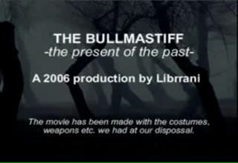
Bullmastiff Video

Slide 9
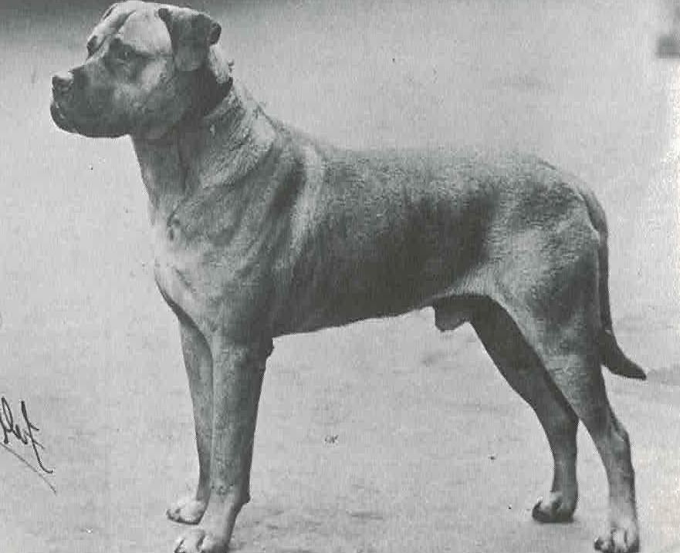
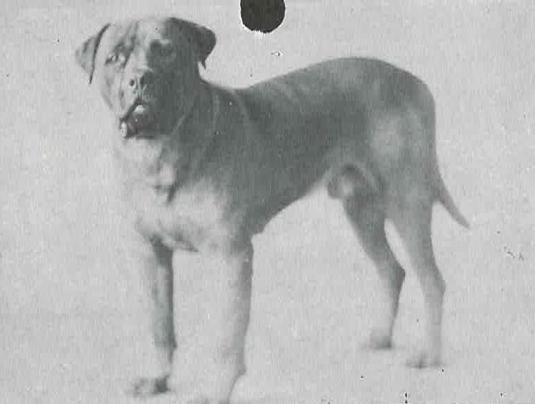
Early Bullmastiffs
Eng. Ch. Tiger Prince
Winner of the first challenge certificate offered to the breed at Crufts in 1928.
Eng. Ch. Roger of the Fenns
(Nov 1929 – Aug 1937)
There is no Bullmastiff in the world today which does not have Ch. Roger of the Fenns as an ancestor. It is also highly probable that this same dog features in post-war Mastiff pedigrees.

Slide 10
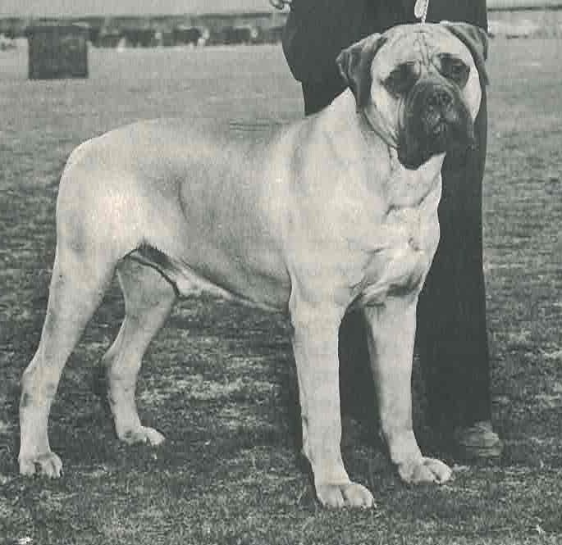
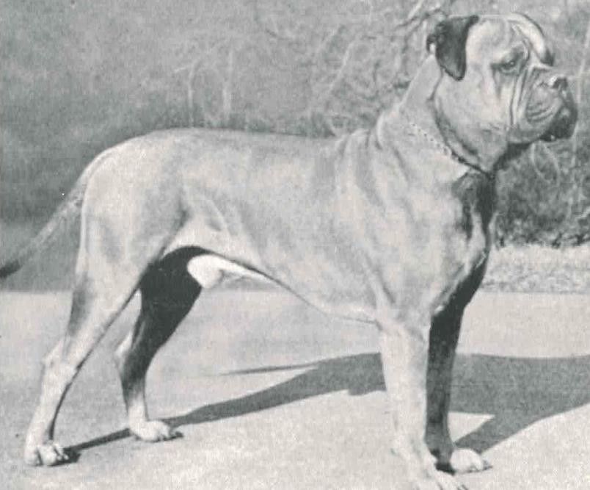
Early Bullmastiffs
Ch. Twit-Lee Rajah
Bred by R. Lee Twitty and owned by Walter and Anita Weinstein, from 1953 to 1958, Rajah won 36 best of breeds out of 37 breeds entered. He won Best of Breed at Westminster five straight years in a row and won his first group placement at Westminster in 1955.
Am. Can. Bermuda Ch. Ritter’s Beau
Winner of the ABA National specialty in 1963 with a record entry of 51, Beau was one of the finest examples of the breed. He was bred by Ted Ritter and owned by Mr. and Mrs. Monge.

Slide 11
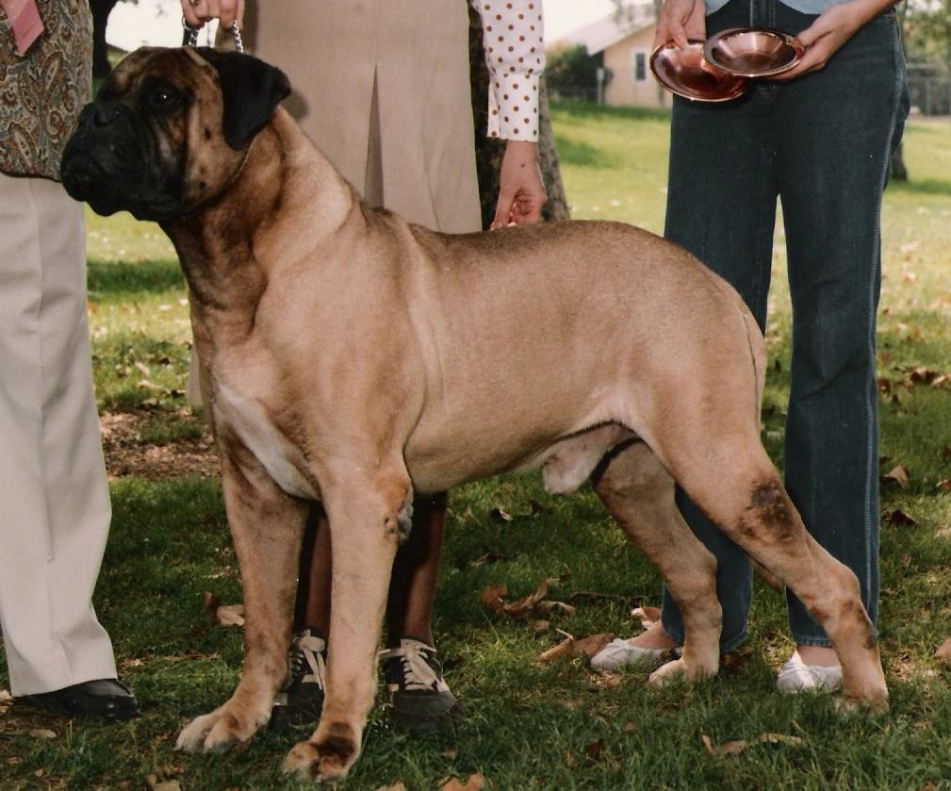
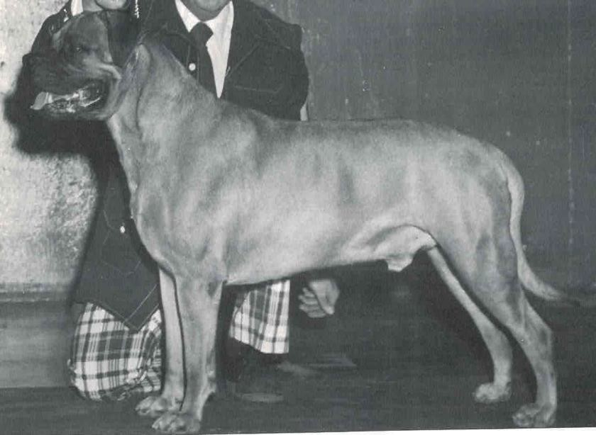
Early Bullmastiffs
Ch. Chit’s Grandson
AKC’s first Bullmastiff Best in Show was on April 27, 1974. Sonny was top Bullmastiff all systems in 1973 and 1974, owner handled.
Ch. Tauralan Vic Torious ROM
(1976–1986)
Vic had the distinct honor of all time top- producing sire from 1985 to 1992 until the title was taken over by his offspring.

Slide 12
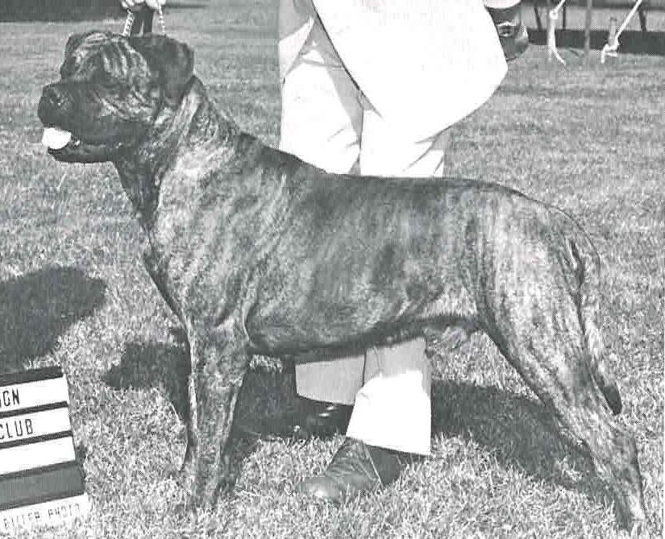
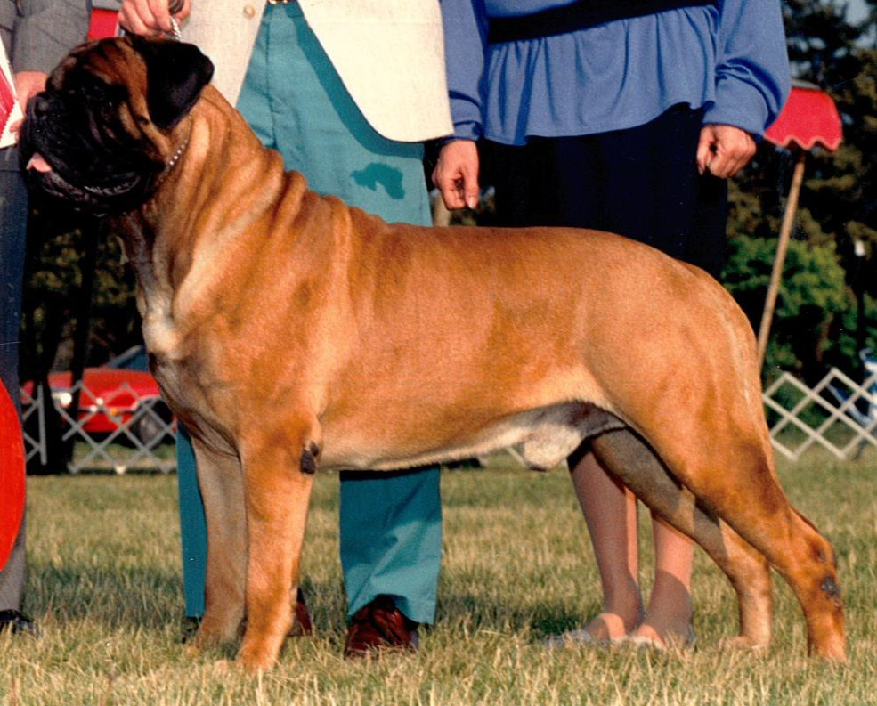
Early Bullmastiffs
Ch. Blackslate’s Boston Brahmin GROM
A multiple Best in Show winner and all-time top- producing sire in the late 80’s, Brahmin was a major type influence.
Ch. Trojan’s Dusty Warrior
AKC’s first and only brindle BIS Bullmastiff , Dusty was the top-winning brindle in the early 1980’s.

Slide 13
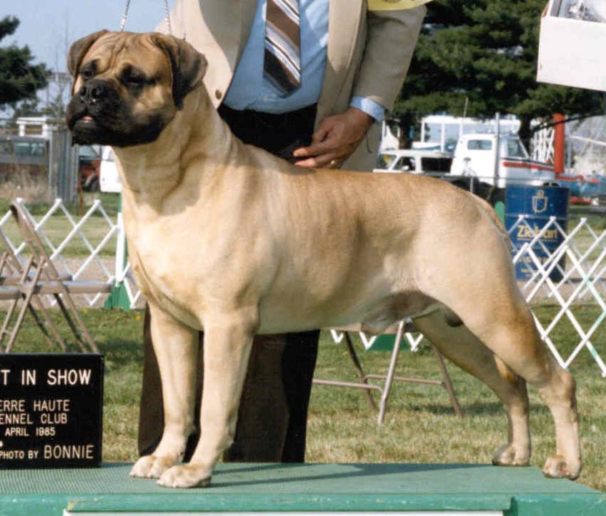
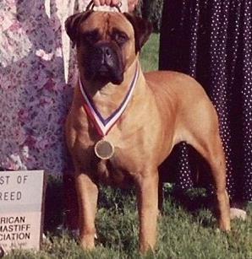
Early Bullmastiffs
Ch. Ladybug Lady Caitlin TD
8/14/87 Top-winning Bullmastiff bitch in the history of the breed with 7 BIS, two National Specialty wins and Best of Breed at the Garden, owner- handled.. Caitlin was shown only 124 times with 96 breed wins and was fourth of the breed to earn a tracking dog title.
Ch. Bandog’s Crawdaddy Gumbo GROM
(1981 - 1993)
Top-winning Bullmastiff in the history of the breed with 37 all-breed BIS, 11 specialty wins, including four National Specialty wins, last time as a veteran. “Waldo” was #1 Bullmastiff in 1984-1986 and #2 dog all breeds in 1985.

Slide 14
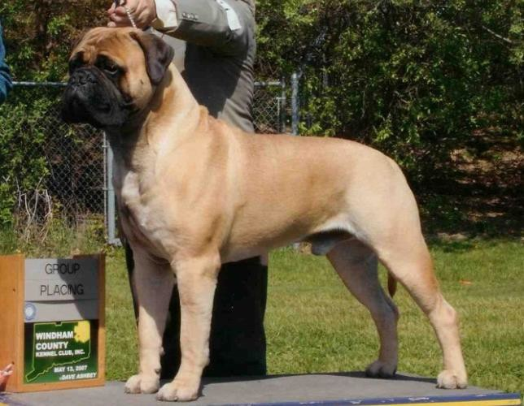
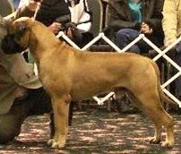
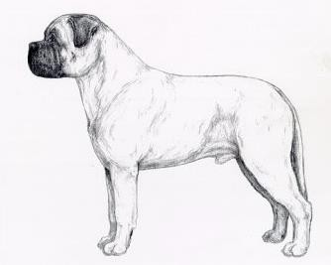
Order of Priority
Outline – It has to look like a Bullmastiff … Nearly Square
Head – Cube on a Cube
Movement – Keep the Soundest Movers
Temperament and Health
Illustrations from the Bullmastiff Illustrated Standard

Slide 15
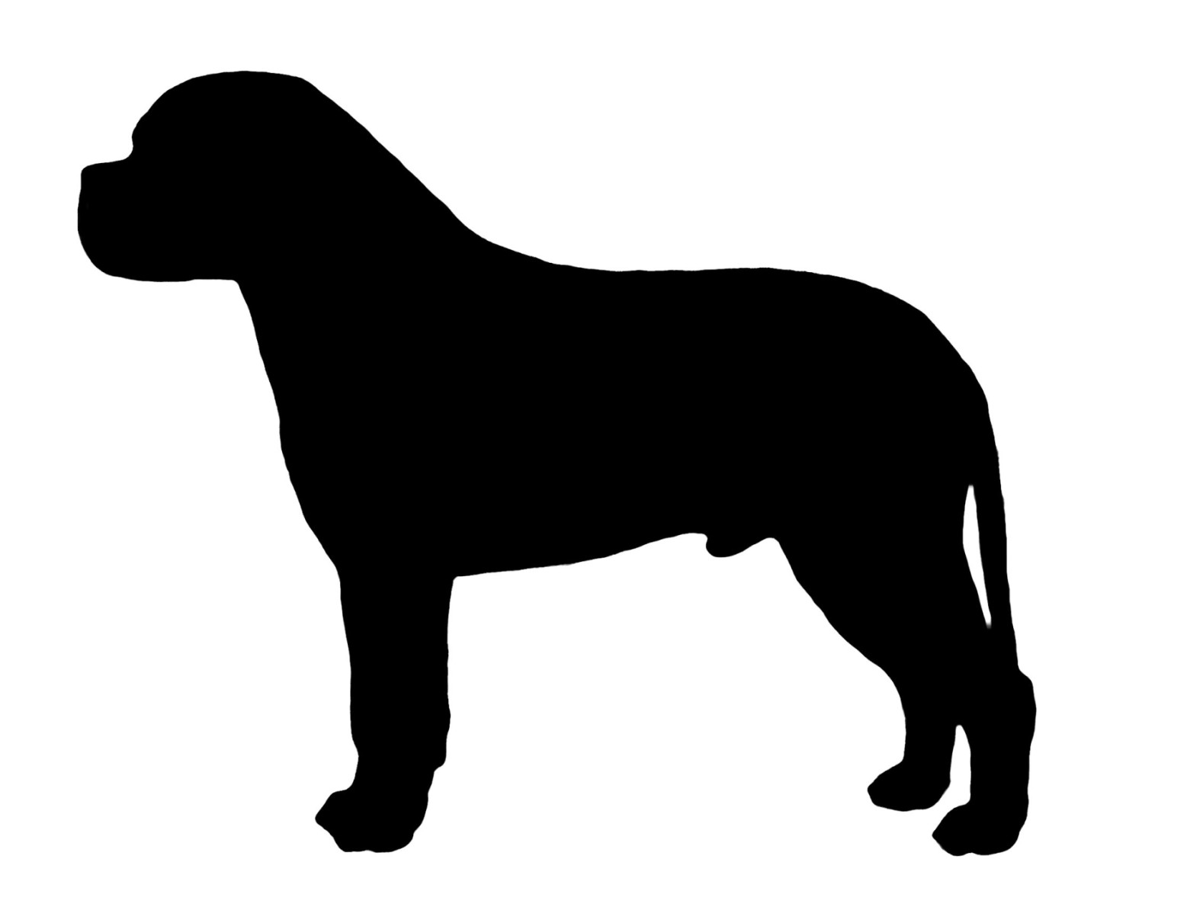
Silhouette

Slide 16
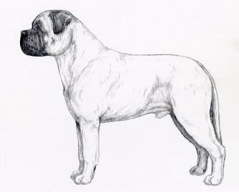
Silhouette

Slide 17
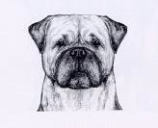
Head

Slide 18
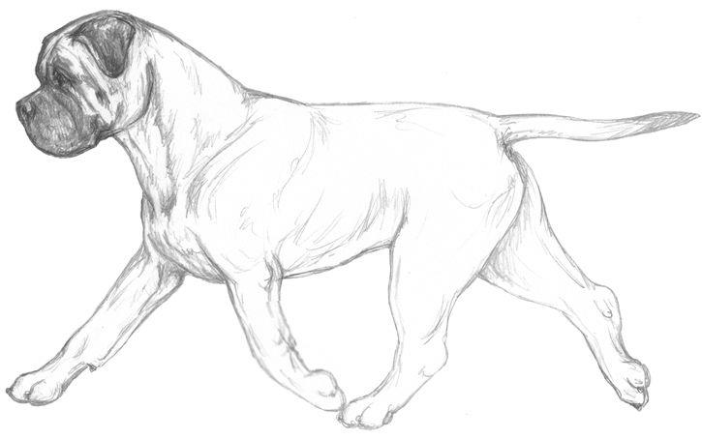
Keep the Soundest Movers

Slide 19
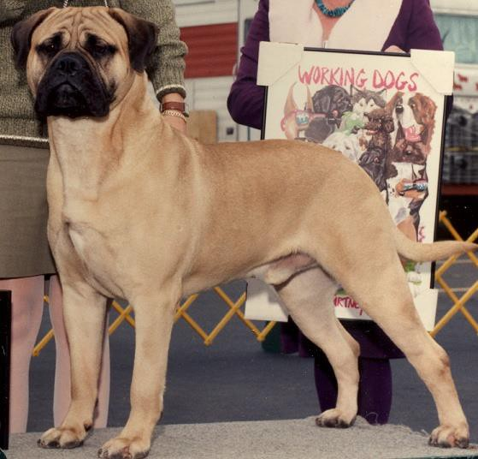
General Appearance
Nearly square
Showing great strength
Powerfully built
Active
Athletic

Slide 20
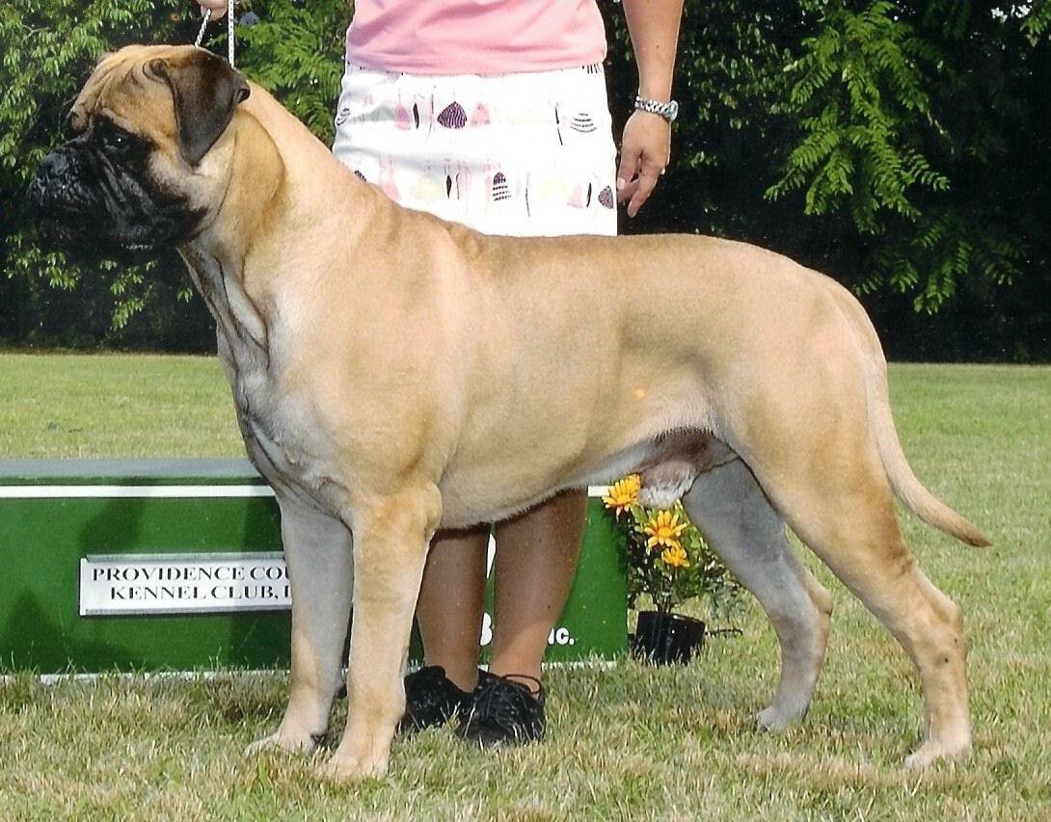
Size, Proportion & Substance
Dogs 25 to 27 inches (110-130 lbs)
Bitches 24 to 26 inches (100-120 lbs)
All things being equal, the more substantial dog within these limits is favored.
This does not mean “bigger is better.”

Slide 21
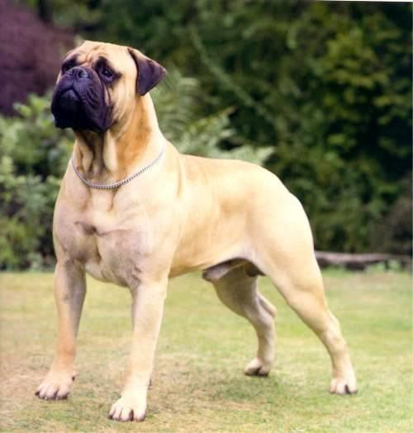
Bullmastiff Ideal Male
Nearly square appearance
Should have equal depth of body to length of leg
Powerfully built
Showing great strength
A “Look of Eagles”

Slide 22
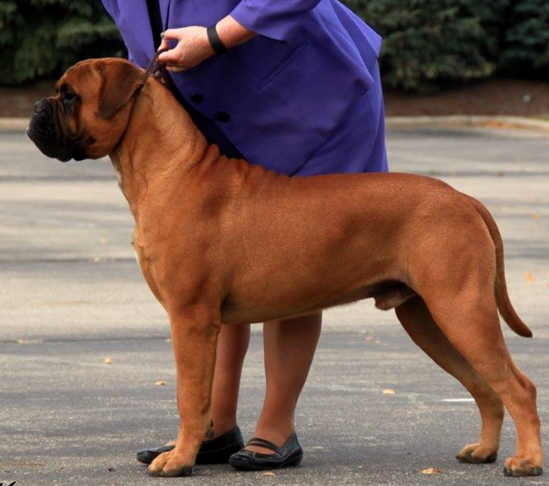
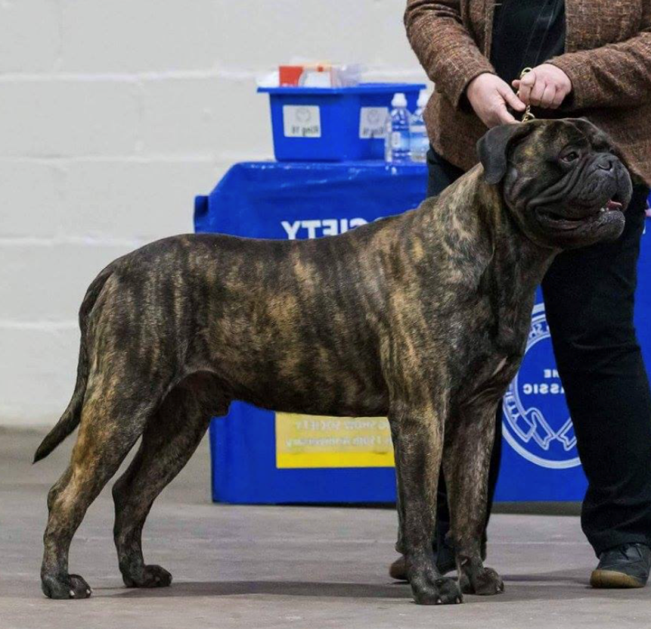
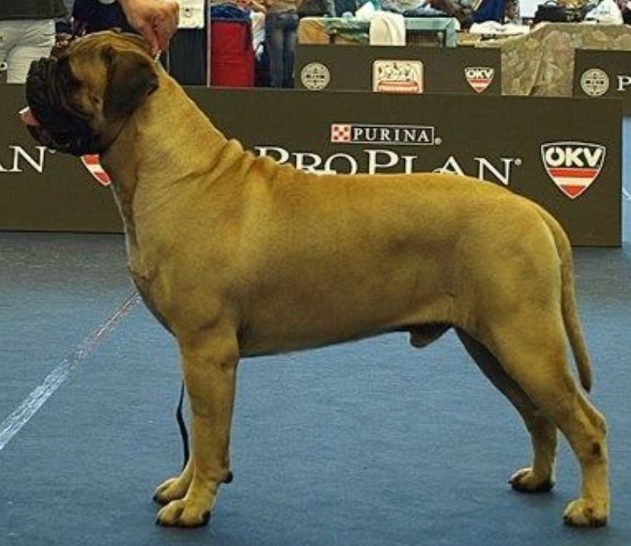
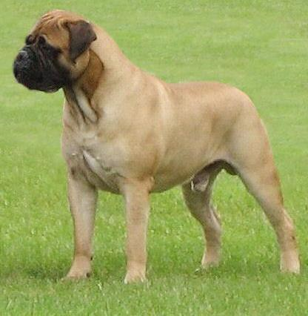
d:\options\word\user templates\GECS Templates\Grey Marble GECS.pot.18Jan02—Page 22

Slide 23
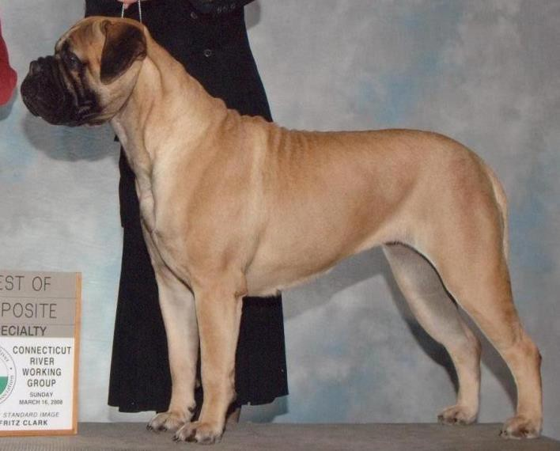
Bullmastiff Typical Female
The bitch should have equal qualities, but an allowance shall be made for the femininity that is characteristic of the bitch
Substantial yet feminine
Should be powerfully built
Compact with equal depth of body to length of leg
d:\options\word\user templates\GECS Templates\Grey Marble GECS.pot.18Jan02—Page 23

Slide 24
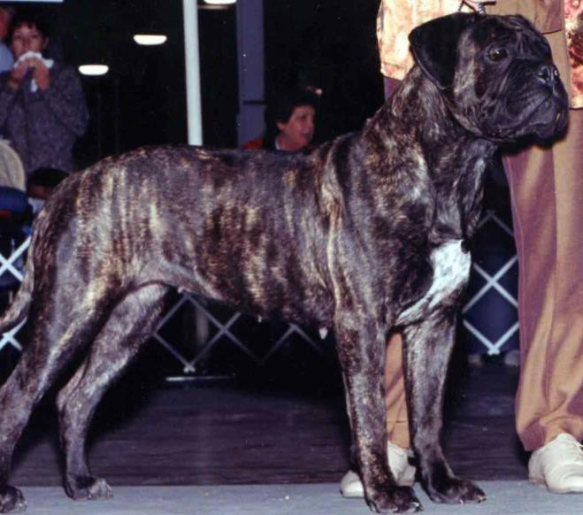
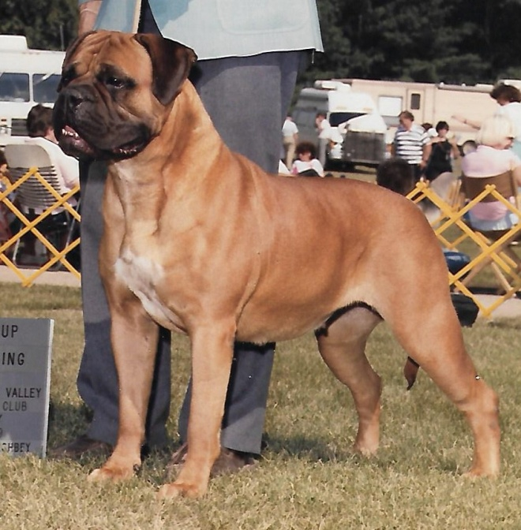
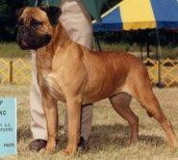
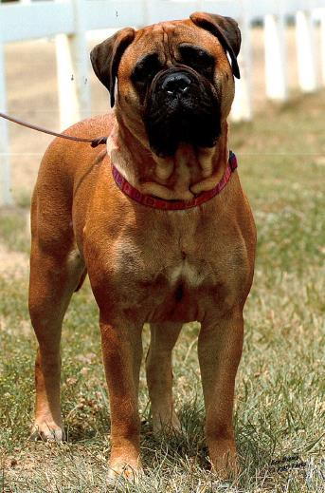
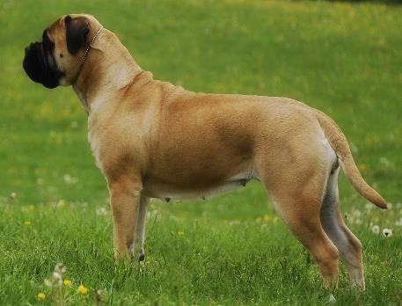
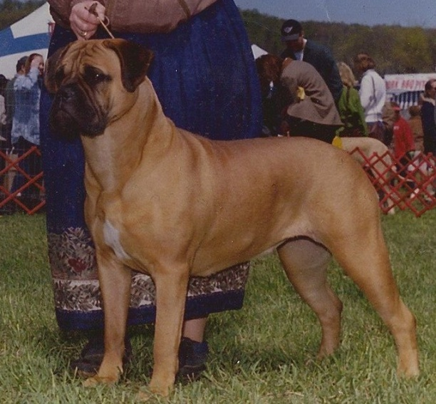

Slide 25
Bullmastiff Typical Female
In comparison of specimens of different sex, due consideration should be made not to favor males, as females do not bear the characteristics of the breed to the same degree of perfection and overall impression as do the males.
If we adhere to form following function, a petite bitch could not knock a man down and hold him. Bitches should proportionately have good bone and substance as their male counterparts (bitches 24-26", 100- 120 pounds). They should also be compact, nearly square. Don’t forgive a long-backed bitch.
Although there may be a place in a breeding program for a sound, typey small bitch, a truly petite bitch should not be rewarded in the show ring. “Other things being equal, the more substantial dog within these
limits is favored.” The reason for this statement should be clear -- a more
substantial dog is better equipped to knock down and hold the poacher.

Slide 26
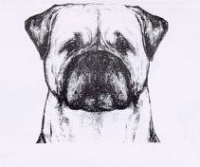
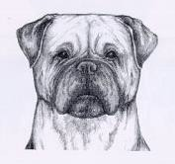
From the Bullmastiff Illustrated Standard
Ideal dog heal
Ideal bitch head
The head of the Bullmastiff is the hallmark of the breed. Good head type is essential, not only for correct appearance, but when the headpiece is properly constructed it is entirely functional.

Slide 27
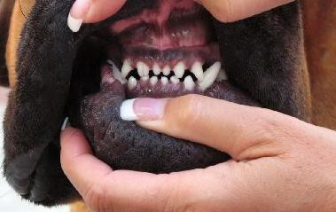
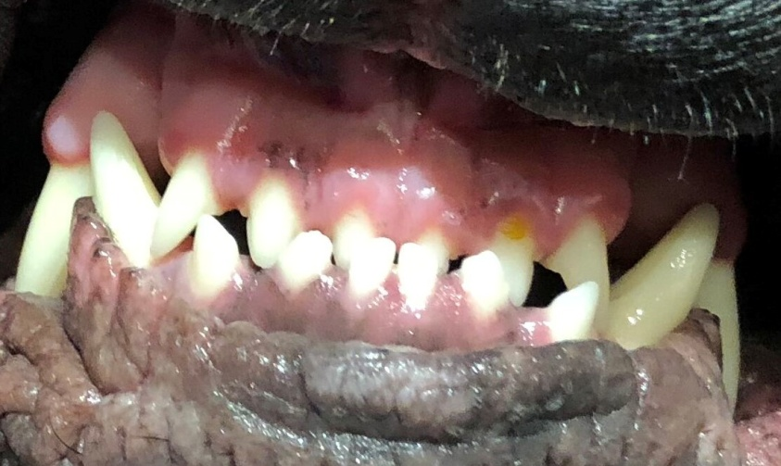
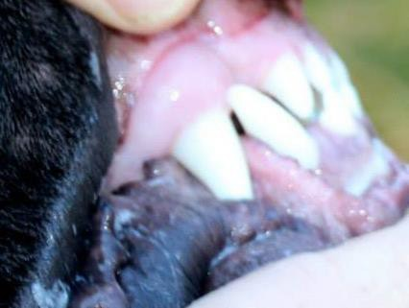
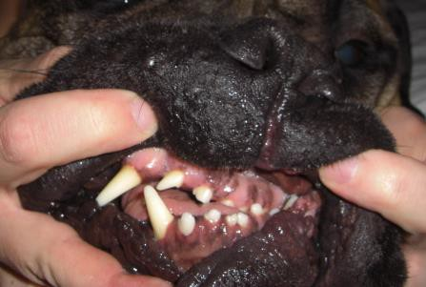
Examples of Bite
Level mouth
Slightly Undershot
Wry mouth

Slide 28
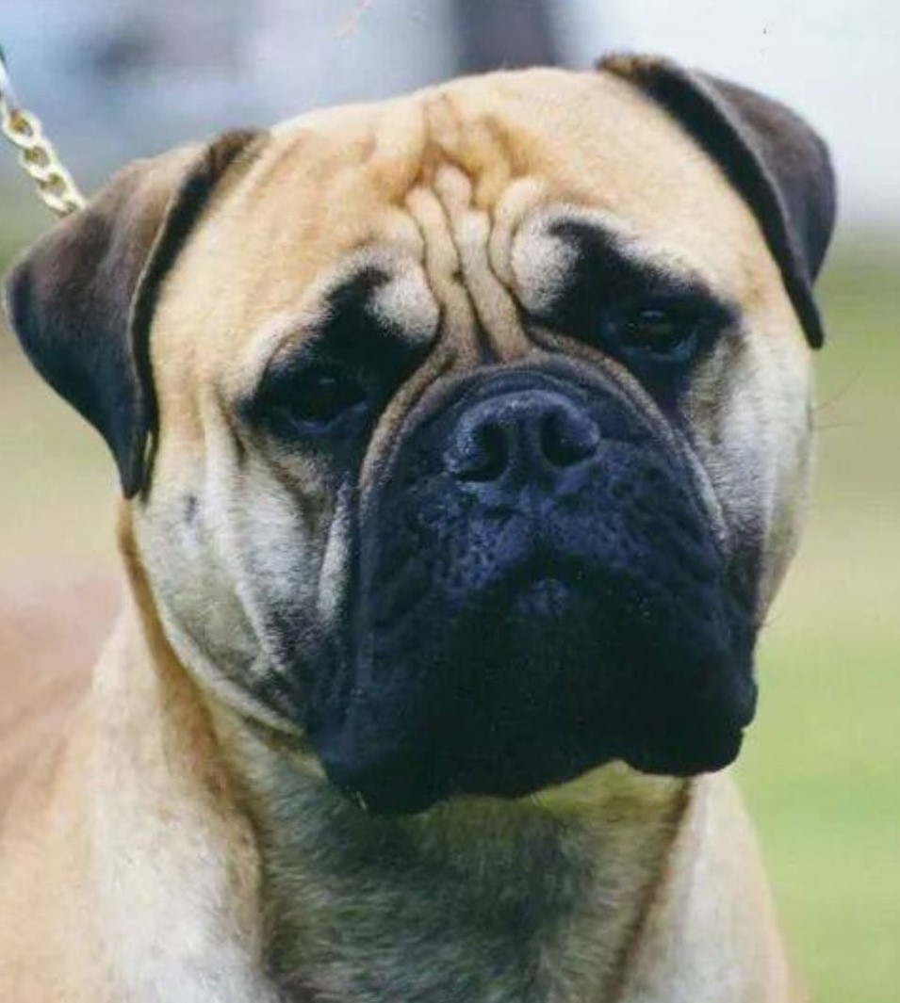
Head
Cube-on-cube
Forehead flat
Cheeks well developed
Fair amount of wrinkle when alert
V-shaped ears, lying close to the skull
Bite level or slightly undershot
Eyes dark and medium in size
They should not resemble Boxers, Am Staffs, Shar Pei, Bulldogs, Rhodesian Ridgebacks or Mastiffs.

Slide 29
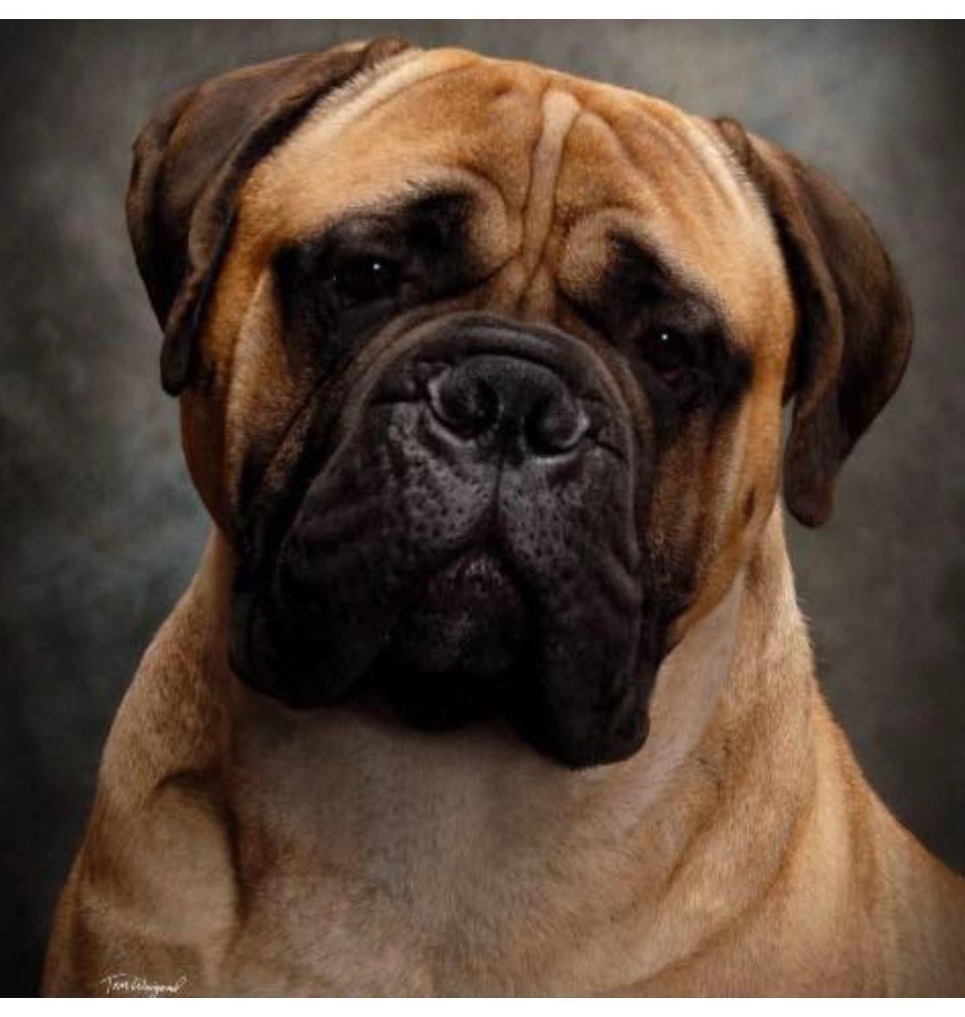
Ideal Male Head

Slide 30
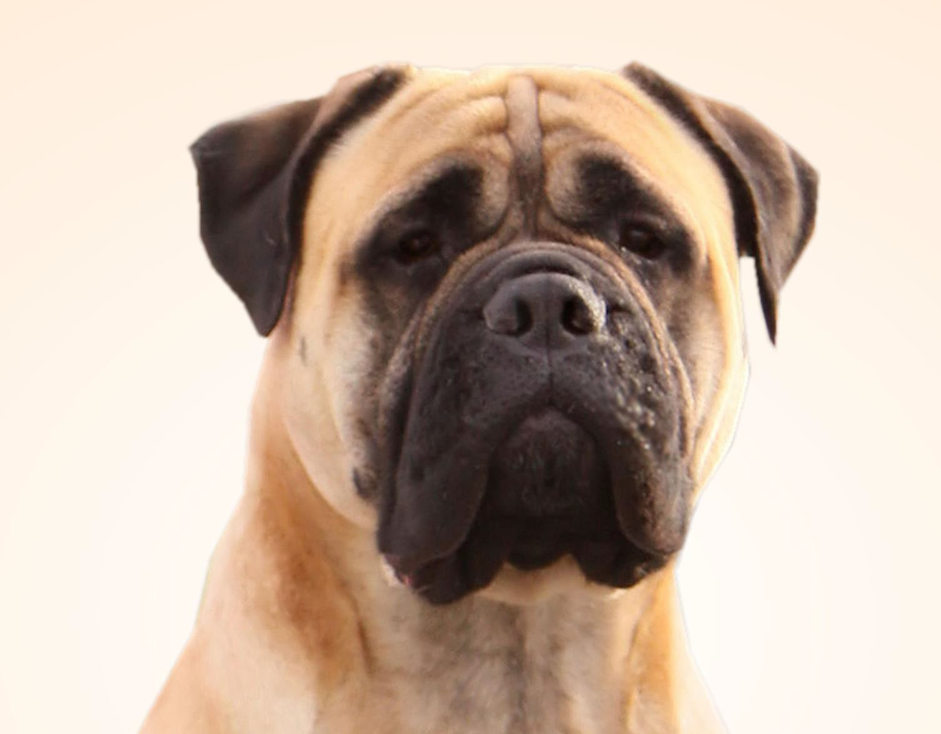
Ideal Female Head

Slide 31
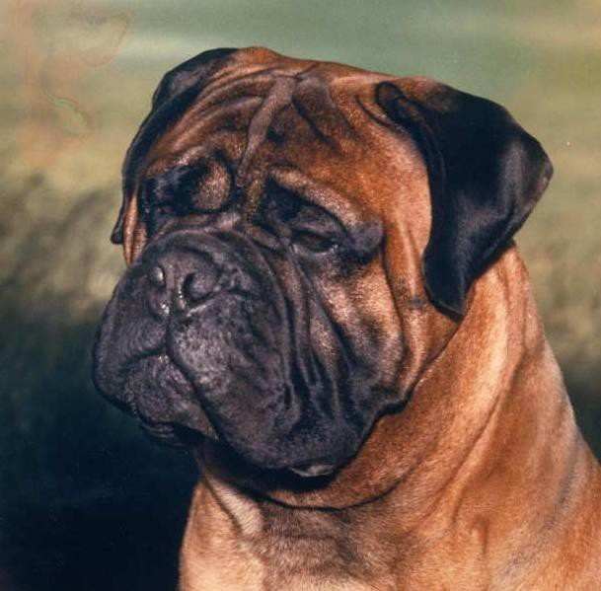
Head
Well-developed cheeks
Moderate stop, forehead flat
Flews not too pendulous
Reversion to Bulldog very undesirable
Nose black with large, open nostrils
Head: 1 as to 3 proportion
Unnecessary to count teeth

Slide 32
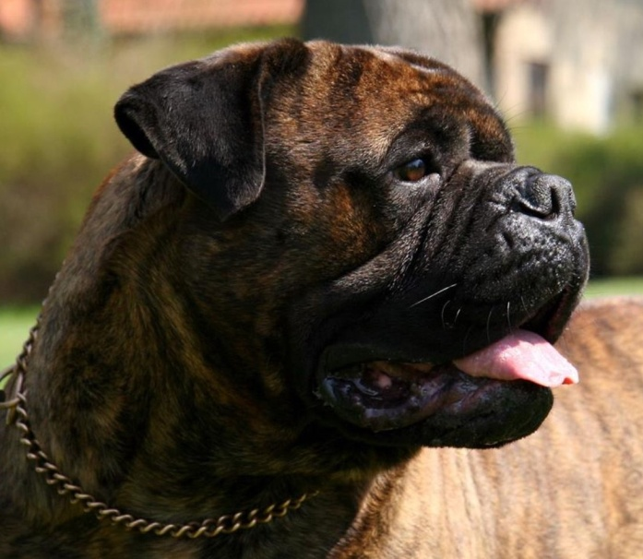
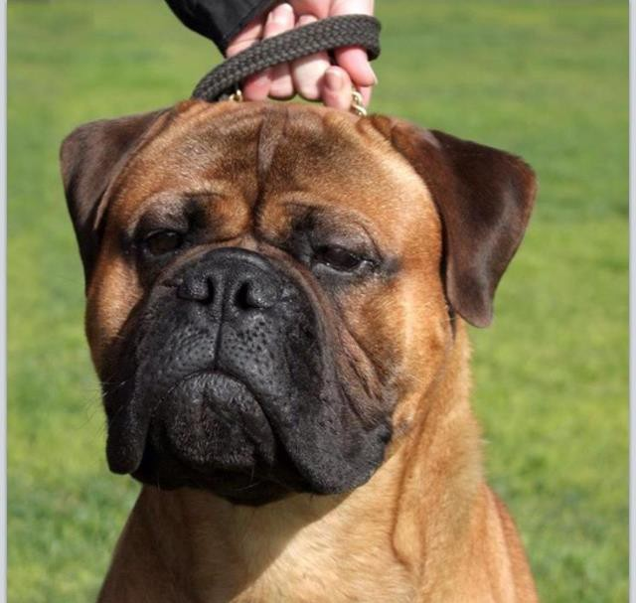
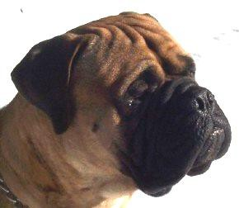



Examples of Typical Male Heads

Slide 33






Examples of Typical Female Heads

Slide 34

Complimentary Male/Female Head

Slide 35


Complimentary Male/Female Head

Slide 36


Complimentary Male/Female Head

Slide 37

Father/Son Consistency

Slide 38


Maturity in a Bullmastiff - Head

Slide 39




Maturity in a Male
3 months
9 months
14 months
2 years

Slide 40

Neck, Topline, Body
Back short, topline straight & level between withers and loin
Body compact
When viewed from top, width at shoulder and rear should essentially be equal
Well balanced – front matchin rear in bone and substance
High tail set, but never carried over the back
Ribs wells sprung
g

Slide 41

Neck, Topline, Body
Muscular but clean
Round, well-arched toes
Straight pasterns
Muscular hindquarters, well-developed second thigh
Short hock
Moderate angulation
Short leg / long back is incorrect

Slide 42


Forequarters

Slide 43

Neck, Topline, Body
Neck slightly arched, almost equal in circumference to skull
Well balanced
Shoulders muscular but not loaded
Straight, stuffy shoulders faulted
Good bone
Well-developed second thigh
Forelegs straight
Topline straight and level between withers and loin

Slide 44


Fronts / Prosternum / Shoulders
The Bullmastiff is wide across the shoulder area but with no exaggerated bulk. He must never appear loaded or bulgy but should have large well defined muscles that are also smooth and powerful both to the touch and sight. The front legs are straight with round and heavy bone right to the feet. The chest is to be well down between the forelegs. There should be no indication of a gothic or ill defined forechest.
A big broad front with plenty of depth between the forelegs is essential. The chest should fill between the forelegs when viewed from the front and the chest should not have a gothic appearance between the front legs. The humerus or upper arm forms a right angle with the scapula. This is the point of the shoulder. The scapula and upper arm (humerus) should be of equal length.
In other words the Bullmastiff is not a short legged dog but rather has just a slight bit more leg under him. The shoulders and upper arms are heavily muscled and powerful looking but should never have a loaded appearance. The bone of the forelegs is round and heavy, the forelegs are set well apart and the elbows are tucked in close to the chest wall. The standard calls for straight pasterns but perhaps a slight slope with give is more desirable as is found in most working dogs.

Slide 45


Hindquarters

Slide 46

Neck, Topline, Body
Length of back. "Body--compact. Back – short.”
This is incorrect!

Slide 47





Slide 48

Maturity in a Male

Slide 49



Maturity in a Male
8 weeks
5 months
3-1/2 years

Slide 50

Maturity in a Female Bullmastiff - Body

Slide 51



Coat
Red Fawn Brindle
Small white patch on chest allowed
Excessive white undesirable
Short, dense, flat-laying top coat with undercoat for weather protection
Dark muzzle preferred, blacker the better
Ears darker than body color

Slide 52



Coat
Red Fawn Brindle
Red color ranges from honey to dark mahogany
Small white patch on chest acceptable, white anywhere else on body very undesirable (throat, feet, underbelly, hindquarters)
Preferred healthy coat, free from allergies
There is no color preference

Slide 53



Coat
Illustrations from the Bullmastiff Illustrated Standard

Slide 54

Judging the Brindle Bullmastiff
It is the brindle gene that is considered to be the key to the coloring
of the Bullmastiff. We must bear in mind that the original
Gamekeeper’s Night Dog was appropriately brindle and therefore assume that brindle was the original color of choice for obvious reasons. Brindle dogs could blend well with the vegetation, with the dark muzzle and ears further providing camouflage even when its head was lifted up to sense, smell or sight the poacher.
There is much diversity in patterning to the brindle Bullmastiff, with no preference, allowing for correct clear coat and proper masking and ear color. Ideally coat color should be clear with even distribution of color, with desirable dark mask and ears. Any pattern of brindle can produce all colors, ie fawn, red, red fawn, lightest to darkest of brindles. There should be no preference regarding color of the Bullmastiff .
There are however certain prejudices toward the brindle Bullmastiff, since the pattern can cause optical illusions in wrinkle pattern in the head and structure in the body. There must be particular attention paid to these illusions to provide unbiased and adequate attention to the brindle Bullmastiff.

Slide 55





Slide 56
Mask / Pigment
The only mention of color in mask/pigment from the AKC Standard is “ears darker in color
than the body,” “a dark muzzle is preferable” and “nose black.”
There is actually no mention of “mask” in our standard. What mask, however, would imply technically would be the “spectacles” around the eyes, which should be dark/black. Mention of muzzle/mask is actually interchanged to describe the pigment of the head.
When evaluating the head and expression of the Bullmastiff, one must consider pigment and masking. The AKC standard asks for a “dark muzzle” and a variable degree of pigment can be seen on the Bullmastiffs of today. Masking and pigment are desired to complete the expression of the Bullmastiff and a completely black mask extending up to the eyes or ears is not any more desirable than a dark mask that covers the muzzle and eye rims. Because dark pigment is so important to maintain Bullmastiff expression, a gray, liver or diluted mask, otherwise known as Dudley pigment (part of an undesirable mutation), should never be rewarded in the ring or used for breeding.
Be wary of how pigment can change the overall look of the head and rely on manual exam to conclude on correct structure not visual. And that while a full black mask may be striking, there will always be a natural blend between body color and the mask/muzzle and start of the ear color. Be suspect of masks that appear dyed or artificial.

Slide 57






Examples of Acceptable Masking
There is always a natural blending of coat color and pigment color in the head. Young dogs carry more pigment and as the dog matures, the mask lessens as the head grows. Be suspect of masks that appear dyed or artificial or have a “dunked in a bucket of black paint” look. Masking is obviously an inheritable trait and as breeding stock the color of the mask should not be artificially enhanced as it is against AKC rules and obviously would not produce the mask that is enhanced.

Slide 58
AKC Rule
Please be aware there has been an increase in the use of artificial means to darken or enhance the mask and muzzle of the Bullmastiff. Judges should be aware of this disturbing and unnecessary practice and should not reward dogs that have been artificially enhanced as a Bullmastiff should always be shown in their natural state. While a beautiful black mask on a clear coat can be initially impressive, over pigmentation, or lack of pigment can change the appearance of the head on first impression and visual exam.
From AKC Rules: A change of appearance is if the dog has been subjected to any type of procedure that has the effect of obscuring, disguising or eliminating any congenital or hereditary abnormality or any undesirable characteristic, or anything that improves a dog’s natural appearance, temperament, bite or
gait. The procedure is the same as with the DQ for attack. The superintendent and AKC Field Representative should be called to the ring and the judge must complete the “DQ for Change of Appearance” form and clearly explain to the
exhibitor that their entry has been disqualified and that it cannot compete at any future AKC event until the dog has been reinstated BEFORE the dog leaves the ring.

Slide 59
Gait
Reach and drive indicate maximum use of the dog’s moderate
angulation with balanced front to back angulation.
Equal emphasis on correct side, down and back movement
They are not herding dogs, and should not be flying around the ring
– slow them down on the go-around!
With short back and moderate angles, the gait is powerful and efficient
It is difficult to breed a balanced dog that is short backed. Many breeders compensate by producing dogs that are long in body. These long-backed dogs may appear to move well, but it is at the expense of proper breed type. Judges should not reward nor should breeders condone a long-backed dog just because it moves well.
Showmanship should not override breed correctness

Slide 60

Gait
Equal lift and propulsion through the shoulders gives a full and complete stride. At a brisk trot this same push and reach is repeated quickly enabling the dog to cover the most amount of ground, in the fewest number of strides, expending the least amount of energy, a true working dog trot.

Slide 61

Gait
A true appraisal of gait is when the dog is moving at a working pace on a loose lead. The dog should move freely and with confidence. When moving, the tail should show confidence but not curled or carried over the back. Movement should demonstrate mental, muscular and skeletal coordination with balance and structural integrity. The efficient Bullmastiff will cover maximum ground with fewer, effortless strides.
  Correct movement from front and rear

Slide 62

Temperament
Confident
Fearless
Docile
Reliable
Willing to please
Stubborn
Protective

Slide 63
Temperament
There should be no allowances made for unprovoked aggression by this breed. There is no place for an unreliable or dangerous dog. This behavior is not acceptable at any time. Timid behavior should be penalized, giving some leeway for very young pups new to a show ring. The Bullmastiff should have an interested, open, alert and accepting attitude, necessary to the reliability required of the breed.

Slide 64

Temperament
Loyal
Dedicated
Affectionate
Tactile

Slide 65

Temperament
Examining a Bullmastiff should not be unlike any
working breed
Approach confidently
Respect his space
Don’t count teeth
Don’t tolerate dog aggression in your ring – move an aggressive dog to the back of the line or excuse
Do not tolerate inappropriate barking in the ring as it tends to agitate the other exhibits
Do not sneak up behind or startle a Bullmastiff
Do not slap a Bullmastiff in fun
Do not grab the dog by the face and talk “cutesy”
Do not stare a Bullmastiff in the eye
Don’t reward a dog with its tail between its legs
But don’t be surprised if you get a “schlurp”
hello!

Slide 66
Temperament
A Bullmastiff with its tail between its legs is afraid, whether or not temporary, it should not be rewarded in the show ring on that day.
Please do not confuse a gay tail with attitude. “Set on high. It may be straight or curved, but never carried hound fashion.” A tail carried over the back is incorrect.
“Gentle Giant” is a misnomer. The Bullmastiff is a guard dog. It will tolerate a lot, but only up to a point. A Bullmastiff must always be treated with respect.

Slide 67
Serious Faults
Cow-hocks
Splayed feet
Lack of foreface (reversion to Bulldog)
Lacking bone, substance, rib spring
Wry bite / grossly undershot bite / overshot bite
Obvious structural faults common to all breeds are as undesirable in the Bullmastiff as in any other breed, even though they are not specifically mentioned in the standard.
Any imbalance in the specimen, whether it is over-angulation, short legs, fine bone, long back, wasted hindquarters, narrow front assembly, lack of rib spring, a dog too big or too small, a dog with no neck or a neck too weedy, would negate the concept of the well-balanced dog.
The tail should never be carried hound fashion
The tail should never be between the back legs
Do not reward a shy dog. A dog shall be judged fundamentally shy if, refusing to stand for examination, it shrinks away from the judge, if it fears an approach from the rear; if it shies at sudden and unusual noises to a marked degree.

Slide 68
Summary
Remember it is the whole dog that counts, and we should be striving
for head type plus soundness, substance plus quality
Substance over superficiality.
By definition, a Bullmastiff can’t be typey if he can’t move soundly. He would have been of no use to a gamekeeper patrolling on foot on a large estate.
Also, a Bullmastiff can’t be typey if he is scared, shy, timid or not sound of mind.
Nor can he be typey if he has trouble breathing freely through
restricted nostrils, suffers from inverted eyelids or weak structure.
He can’t be typey if he’s long-backed.
Showmanship should not override breed correctness.

Slide 69
umS u m m a r y
S
Any deviation from this ideal should be
penalized to the extent of the deviation.
Deviations that impact performance and function should be considered more serious than those that affect only appearance.

Slide 70


Bullmastiff / Mastiff Comparison
Mastiffs are:
A much bigger dog, Mastiff standard calls for massive head and body. A Bullmastiff should not be 160 pounds!!!
Longer in body – Mastiffs are rectangular, Bullmastiffs are nearly square
The antithesis of a compact bodied-Bullmastiff
Mastiff standard calls for preferred scissors bite, Bullmastiff level or slightly undershot
Proportion and size is what defines the major difference in the breeds

Slide 71
Recommended Bullmastiff Specific Reading
The Bullmastiff - Peerless Protector, Jack Shastid & Geraldine Roach c. 1999
The Bullmastiff Manual, Bill Walkey c.1999 2nd edition
The Bullmastiff, L.B.Hubbard c. 1986
The Bullmastiff Fancier's Manual, Bill Walkey c. 1992
Everyone's Guide to the Bullmastiff, Carol Beans c. 1997
Bullmastiffs Today, Lyn Pratt c. 1996
The Bullmastiff - A Breeder's Guide, Vol. I David Hancock c. 1996
The Mastiff and Bullmastiff Handbook, Douglas Oliff c. 1988
Raising a Bullmastiff Puppy, Mona Lindau-Webb c. 1997 (Available from
Ms. Webb at tikiwiki@mindspring.com)
The Millenium Book of Bullmastiff Champions, Published in England c. 1999

Slide 72
Recommended Reading
Canine Terminology (Spira)
The Dog in Action (McDowell)
Dog Steps (Elliot)
Born to Win (Trotter)
Tricks of the Trade (Hastings)
The Winning Edge (Alston)
New Secrets of Successful Show Dog Handling (Green)
The Joy of Breeding Your Own Show Dog (Serance, Sammet, Gasow, Morden)
Solving the Mysteries of Breed Type (Beauchamp)
Breeding Better Dogs (Battaglia)
K-9 Structure and Terminology (Gilbert)

Slide 73

Therapy Dog

Slide 74


Best Friends

Slide 75

Bullmastiff Puppies

Slide 76

Brindle, Red and Fawn Bitches

Slide 77


Juniors Dog

Slide 78



Agility

Slide 79




Obedience and Rally

Slide 80


Dock Diving

Slide 81




Tracking

Slide 82



Lure Coursing and Nosework

Slide 83

The End
Property of the American Bullmastiff Association

